Slide 1



Car-Nerd
Phase Two
Dynamic Developers

Slide 2
Introduction
System Design
Phase Two:
The objective of this presentation is to detail how the proposed Car-Nerd desktop application will be constructed.
Intention is to provide users with an effective way to maintain information for their personal vehicles.
Will translate required program specifications for developers and users.
Identify hardware and software requirements, as well as present user interface components.

Slide 3
Introduction
Actions:
Chronicle requirements needed to define the architecture and system design of the application and provide the development team guidance on system creation.
Systems Overview:
Vehicle owners have had the time consuming tasks of having to keep track of vehicle service records.
> 1 vehicle, tasks take even more time and more organization.
proposed solution will improve the organization and management of personal vehicles.

Slide 4

Introduction
Project Goals include:
Ability to add a vehicle to the application and give the vehicle a personalized name
Ability to add year, make, and model to vehicle profile
Ability to schedule service reminders
Track oil changes
Track mileage
Track details for multiple vehicles in one central location
Ability to charge a user a monthly or yearly subscription fee for the application service ($3.99/mo or $39.99/yr)
Be user friendly
Goals

Slide 5
Hardware and Software
Hardware:
The Car-Nerd product does not require any specialized hardware.
It is to be developed on standard Windows computers and will run on Windows computers.
Software:
The Car-Nerd product will be developed using Java and Eclipse.
Swing libraries will be used for GUI functionality.
Other libraries will be used if and as we discover convenient ways to add features using new libraries, e.g. Paypal support.

Slide 6
Database Design
The database that is featured within Car-Nerd assists with the integrity of the user entered data:
Data assists the user when inputting their vehicle information that they have the proper information for their car.
Database is a static list of all year, make and models for the last 25 years currently available in the US.
The user will first input a year, then based on the year entered, any car manufacturers that have vehicles available within that year will populate.
Any manufacturers that do not have any vehicles manufactured within that year will not be selectable.
Once manufacturer has been selected, available models will populate, excluding any options that are not available for that year.
Any cars above and beyond 25 years must be manually added to the application due to the inability to track imports.

Slide 7
System Security and Data Integrity
Internal Security for our application will be more user based since the data they enter will be stored locally and only on their machine in the form of a text file.
User will have the ability to retrieve their data from the database at their choosing should they need to, since data will be stored on their local machine.
Login data from logging into the application will be handled through the use of the Google API and no data will be stored by Dynamic Developers in any instance.
Additionally, the ability to check user data files will be convenient for the user as they will just have to check the install folder for the text file.
Notes:
Security in our app is somewhat user based, as all data is secured onto the user’s computer in a text file, such as all the car information and the notes for each car.

Slide 8
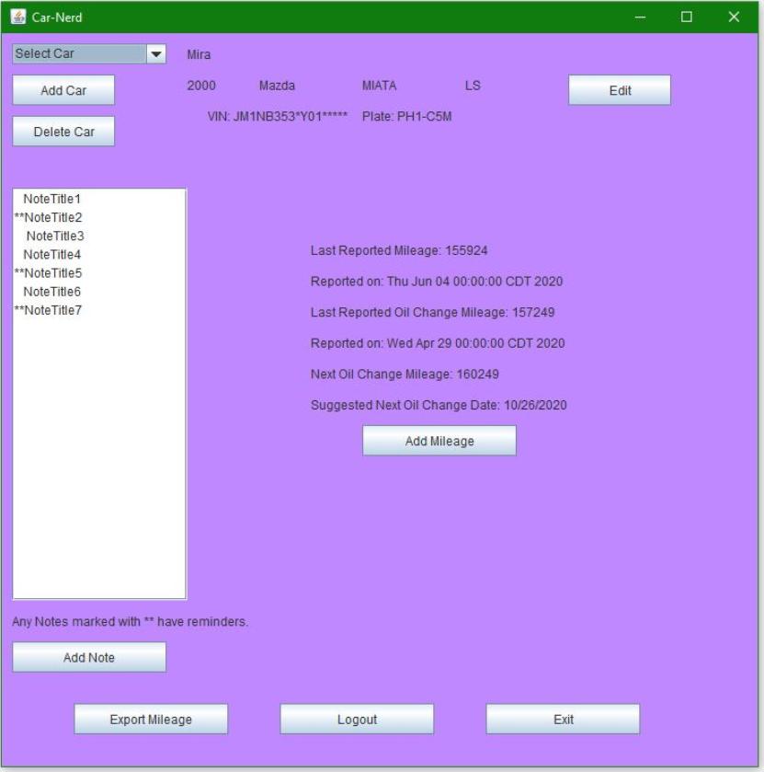
UI design
The design of the user interface is locate on the main page of the application. This gives the user the ability to see a all vehicle details in a “snapshot” view.
Add Mileage - When the user selects a vehicle they will be asked for their current mileage. This information is stored along with the date.
Mileage is tracked for maintenance checks and as reference for the users to see how far they travel in a given timeframe.
Add Note – allows user to enter service reminders and denotes which events have an alert set.
Notes:
This screen/module is the log screen, in which the user will be able to set reminders and record notes for separate vehicles. Also the app will display whatever car is currently selected through the car menu in the top through the name, make, model, year, and trim. In addition to this, the user will be able to select which note they’d like to edit or to create a new one using a dropdown menu, in which all notes for the current car are shown. Transistion to Alyssa

Slide 9
System architecture
Hardware:
Hardware components and setup range between the group, however, all developer setups are able to successfully and effectively work on the system design:
Developer Computers consisting of: - 8GHz Server Suite - RAM: 8 GB - 6x 80GB 15,000 RPM Hard Drive - 6x Power Cord + Charger - 1 TB SAN Storage Device - 6x Dell P3000 Workstations - 6x Viable Wifi Routers
Software: Car-Nerd works with various components in conjunction to store and display user inputted data. The components the team currently has is as follows:
Ability to add a vehicle to the app and/or select a previously added vehicle.
Users can specify a name, the make, model, trim, and year for the vehicle they have added.
Store reminders, and give ability to log maintenance service data.
Time tracking
Notes
Displays events added to log
Hold and calculate the mileage of the user's vehicle.
Mileage at last oil change
Current mileage
Date of last oil change
Provide users with a logout function.
Google API: Gives user google login access to store and hold data.

Slide 10
Architectural Graph
Notes:
Hardware:
Dynamic Developers is a small team based company where due to the global climate, team members are working remotely. Therefore, hardware components and setup range between the group, however, all developer setups are able to successfully and effectively work on system design, including UI work and the coding of the application.
Developer Computers consisting of: - 8GHz Server Suite - RAM: 8 GB - 6x 80GB 15,000 RPM Hard Drive - 6x Power Cord + Charger - 1 TB SAN Storage Device - 6x Dell P3000 Workstations - 6x Viable Wifi Routers
Software: Dynamic Developers’ application works with various components in conjunction to store and display user inputted data. The software creates a database in which input can be entered and modified by users to make information easily accessible by the user. The components the team currently has is as follows:
Car Tab: Ability to add a vehicle to the app and/or select a previously added vehicle.
Info Tab: Users can specify a name, the make, model, and year for the vehicle they have added.
Log and Reminder Tab: Stores reminders, and gives ability to log maintenance service data.
Time tracking
Notes
Displays events added to log
Mileage Tab: Holds and calculates the mileage of the users vehicle.
Mileage at last oil change
Current mileage
Date of last oil change
Settings Tab: Provides users with logout function.
Google API: Gives user google login access to store and hold data.

Slide 11
Design Constraints
The team has identified a few limitations that will have an impact on the design process. To date, the limitations are as follows:
Finding the time to create Car-Nerd is a challenge due to the team members having multiple priorities, and being in separate locations working remotely. Schedule conflicts also play a role in this limitation.
With Car-Nerd only being deployed as a desktop application, users will not have access to it when they are away from their computer which impacts the overall design appeal of the application. Additionally, access to the internet is required, so there is no offline functionality.
Some team members are not versed in some of the applications being used to create and maintain Car-Nerd, such as GitHub and Java. This impacts the design process as the team has to learn these applications while at the same time, contributing to the design process.

Slide 12

Questions

Slide 13
References
Car-Nerd. (2020, June 6). Phase Two Meeting Notes. Dynamic Developers, Cottleville, MO.
Car-Nerd. (2020, June 10). Phase Two Meeting Notes. Dynamic Developers, Cottleville, MO.
Car-Nerd. (2020, June 15). Phase Two Meeting Notes. Dynamic Developers, Cottleville, MO.
Car-Nerd. (2020, June 17). Phase Two Meeting Notes. Dynamic Developers, Cottleville, MO.
Car-Nerd. (2020, June 20). Phase Two Meeting Notes. Dynamic Developers, Cottleville, MO.
Car-Nerd. (2020, June 22). Phase Two Meeting Notes. Dynamic Developers, Cottleville, MO.
Car-Nerd. (2020, June 23). Phase Two Meeting Notes. Dynamic Developers, Cottleville, MO.

